Slide 1

DATABASE FINAL PROJECT
SHOPPING
CART
SUBMITTERS :
Guy Simai - 316550060
Noam Sella - 207702929
Shlomi Ashkenazi - 209398031

Slide 2

GENERAL DESCRIPTION
original (java) program:
The original Java program is designed as an online shopping system that manages a store's stock and a customer's shopping cart. It allows users to interact with a digital catalog of products, add or remove items from their shopping cart, and update the quantity of items in the cart. The system also provides functionality to sort and present the products in stock based on various criteria such as category, name, or quantity.

Slide 3
REQUIREMENTS FOR THE SYSTEM
WHAT IS THE DATABASE FOR?
The database is intended to store and manage all the data related to the online shopping system.
Product Information: Details about each product, including category, name, quantity, and any specific attributes.
Shopping Cart: Details about the products the user has added to their cart, timestamps, along quantities.
Stock Management: Information about the current stock levels of each product. The database tracks the quantity of each product in the inventory, ensuring that the system can update stock levels when purchases are made or products are added or removed from the catalog.
Eventually, this database is essential for ensuring data persistence, enabling complex queries, and maintaining a structured, scalable system.

Slide 4

SYSTEM USER
01
Ability to browse the product catalog
02
manage the shopping cart (add, update, and remove items)
03
Show client shopping cart

Slide 5
ENTITYS
Product
Stock
Cart
Attributes: Product_ID, productName, category.
Description: Represents the items available in the store. Each product belongs to a specific category (Books, Clothing, Electronics) and has specific attributes (e.g., size, author). Products are managed by the system and stored in stock.
Attributes: Product_ID, quantity
Description: Represents the inventory of all products in the store. Each product has a quantity associated with it, which indicates how many units are available in stock. The stock is managed by the system and is linked to the products.
Attributes: Product_ID, quantity, timeStamp
Description: Represents a user's shopping cart. It contains products that the user intends to purchase, along with the quantity of each product. The timeStamp attribute may indicate when a product was added to the cart.

Slide 6
Product
ISA
Clothing
Electronic
Books
Attributes: ProductID,productName,
size,color,category
Attributes: product_id , productName, model , company, category
Attributes: product_id, productName, pages, author, category

Slide 7
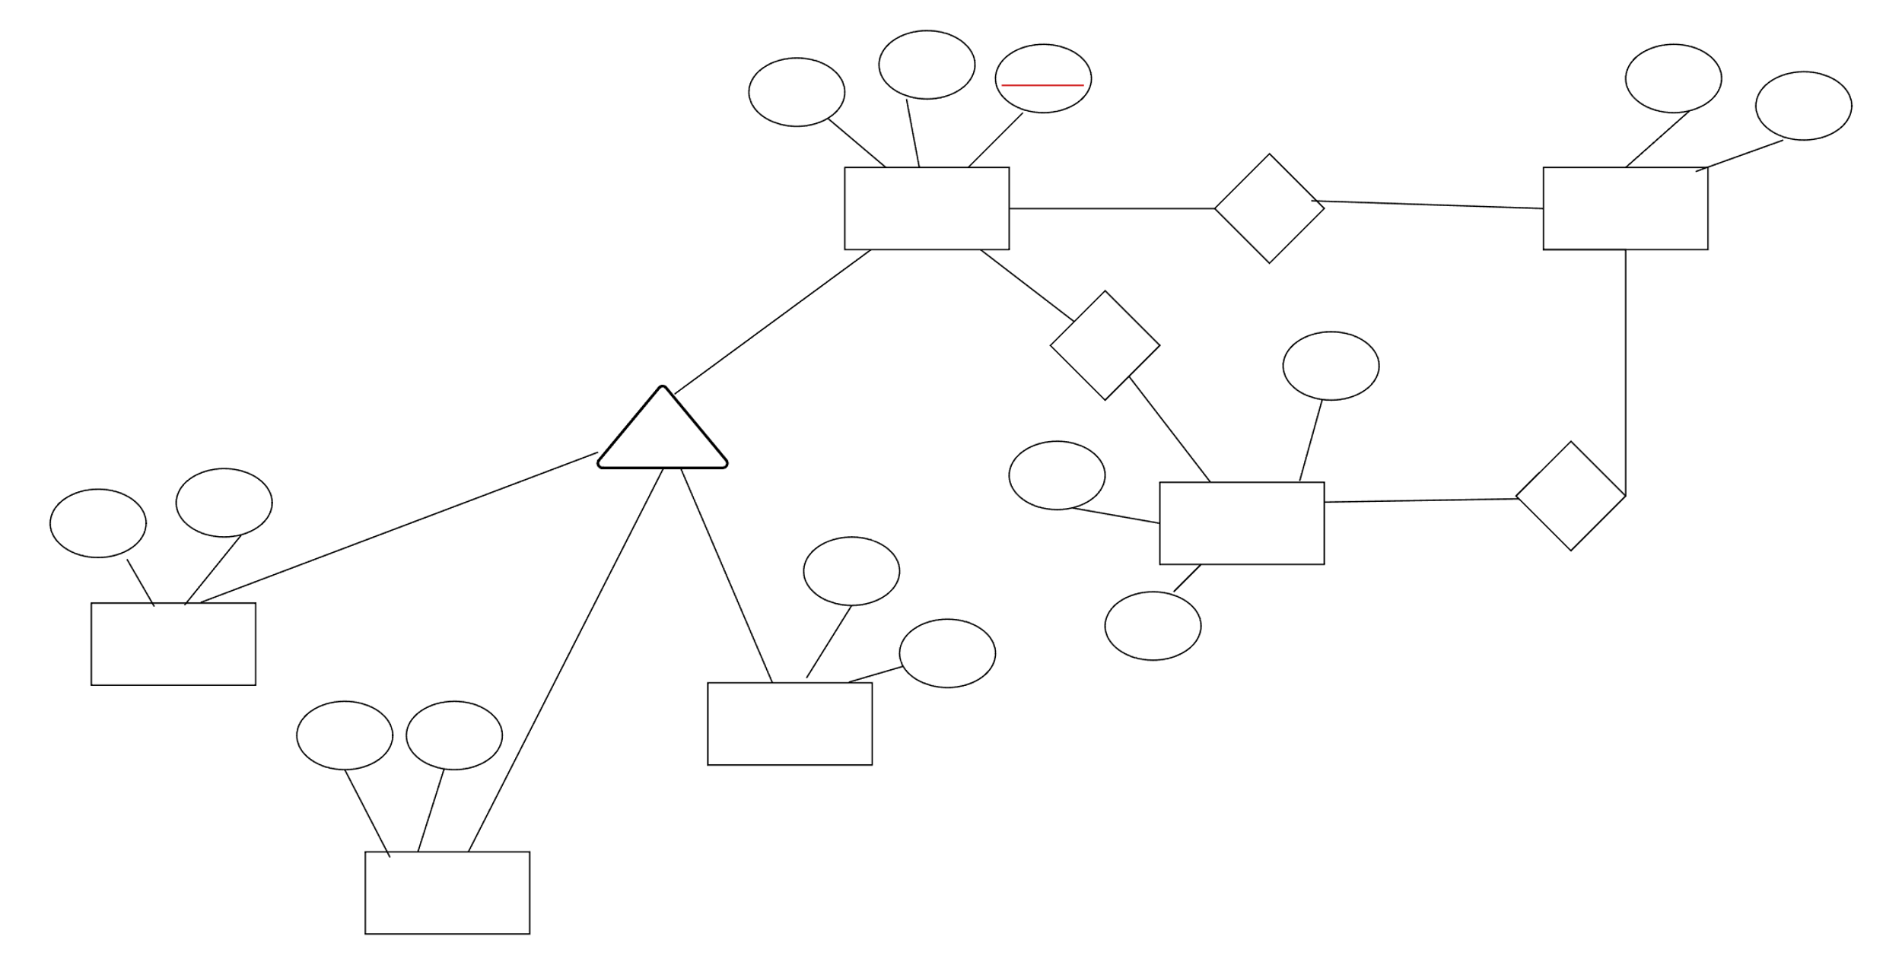
ERD Diagram
productName
Product_ID
quantity
category
Product_ID
PRODUCT
N
contains
1
STOCK
N
contains
1
timeStamp
ISA
1
quantity
updates
Pages
Author
Cart
1
Model
BOOKS
Product_ID
Company
Size
Color
sex
Electronics
CLOTHING

Slide 8
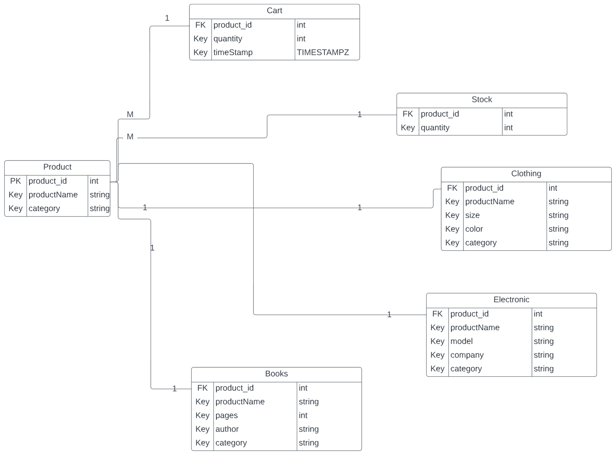
Generalization Table

Slide 9
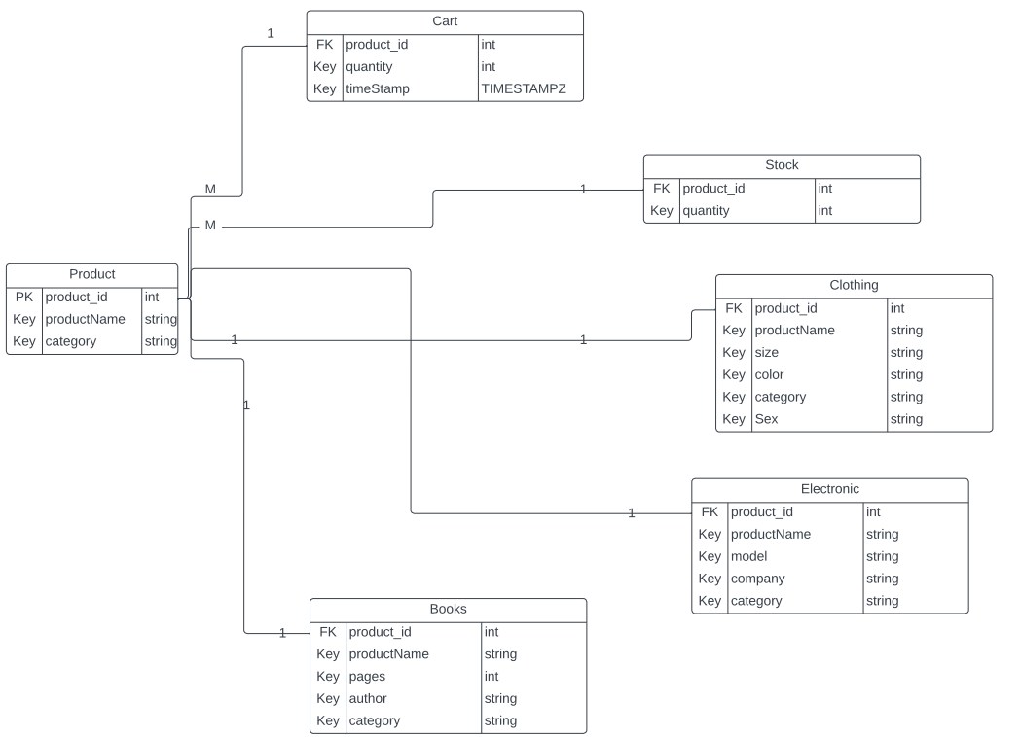
Generalization Table

Slide 10

Thank you!

